Slide 1

QER11691
QER: JULIMAR DEVELOPMENT PHASE 3 SF301229C002.05+06+07 - Zeta wires unlocked

Slide 2
Pipe section / Details
Item | Traceability / identification
Project number | SF301229C002
Project name | JULIMAR DEVELOPMENT PHASE 3
Pipe section | SF301229C002.05+06+07
ST number | ST203.72124
Affected layer / equipment | Zeta Pressure Vault
Length affected | 44.8mm
Drawing number / MP code / STA / Dimension | ZETA 6.2 FI09 (MP205)

Slide 3
Overview of anomaly
Problem Description :-
During the zeta spiraling of JULIMAR DEVELOPMENT PHASE 3 SF301229C002.05+06+07 (ST203.72124), zeta wire unlocked was detected at length 44.8m on the pipe.
Root Cause :-
The root cause due to wires entangled in bobbin #002 during running causing wire damage and wire unlock at laying point.
CA:
Re-brief to the winding crew on the importance of wire arrangement in bobbin during winding process.
Problem Handling:-
Reparation by un-spiral has been performed to re-position the wires to be in a good spiral. Thus, this reparation was accepted as it is and the dimensional after the repair are within the criteria.

Slide 4
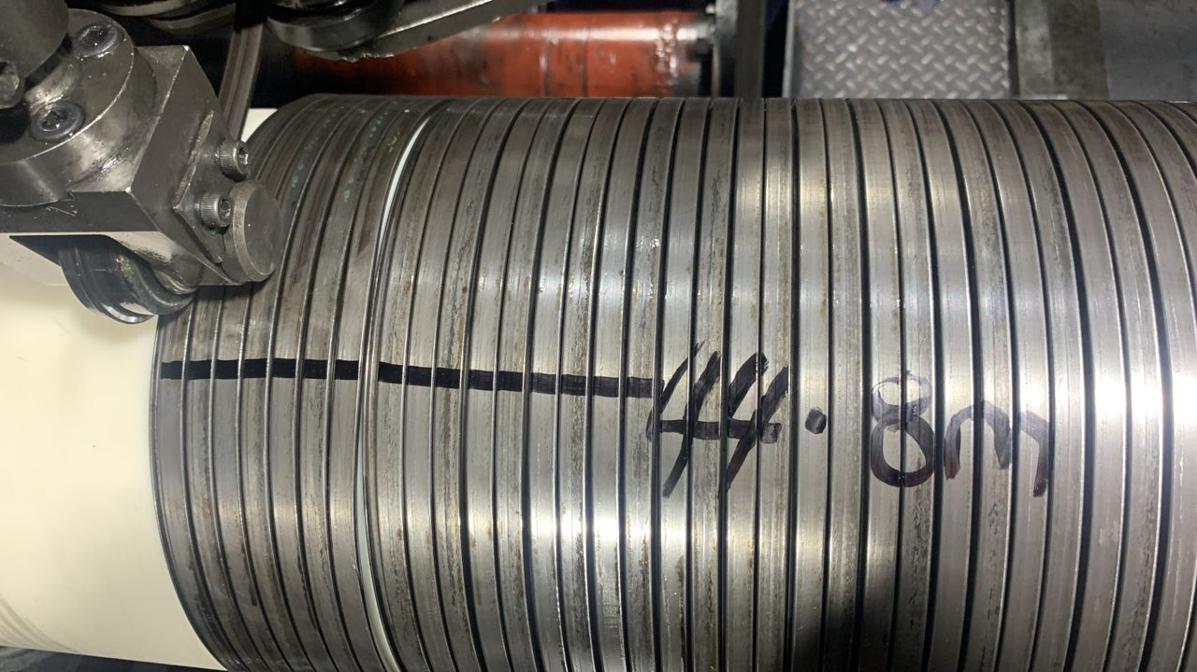
Defect Photos
Figure 1 : Zeta wire unlocked was detected at length 44.8m on the pipe.

Slide 5
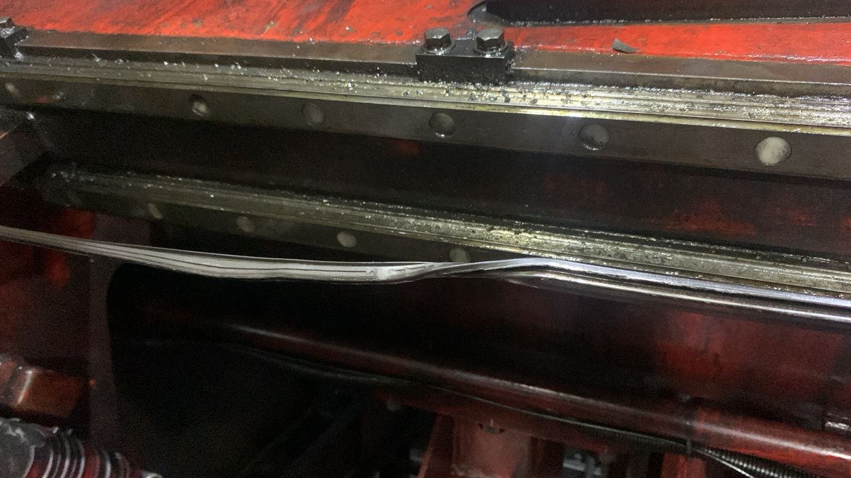
Wire damaged due to entangled
Figure 2 : Damage wire detected due to entangled during running

Slide 6
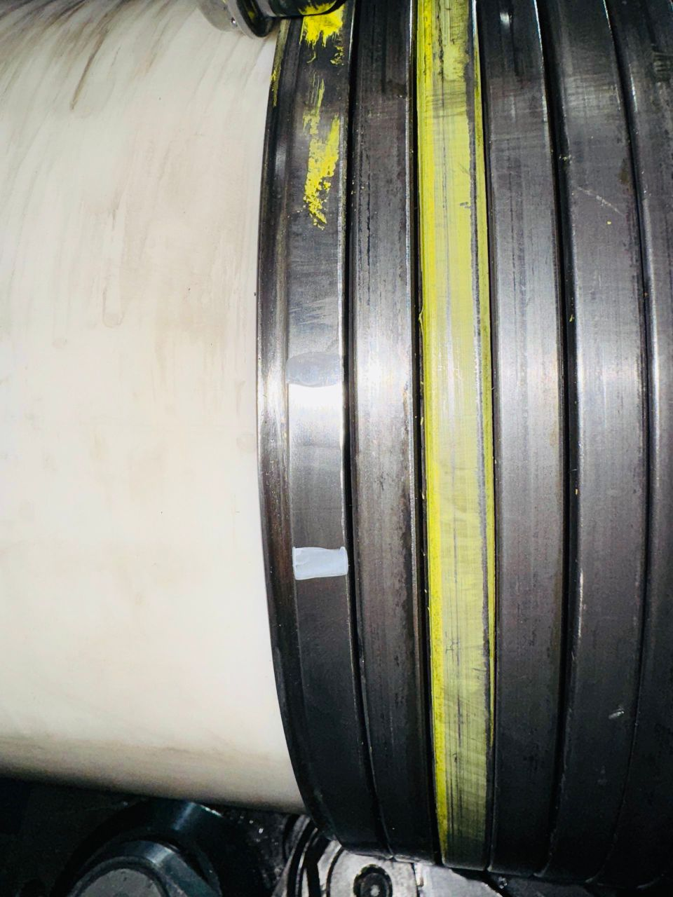
After repaired
Figure 3 : Reparation by un-spiral has been performed to re-position the wires to be in a good spiral. Thus, this reparation was accepted as it is and the dimensional after the repair is within the criteria.

Slide 7

THANK YOU

